Slide 1
Leeds Beckett University
Cloud Computing Development
Dr Anatoliy Gorbenko
E-mail: A.Gorbenko@leedsbeckett.ac.uk Office: CAE118
Kiran Voderhobli
E-mail: k.voderhobli@leedsbeckett.ac.uk Office: CAE228

Slide 2
Cloud Computing Development
Lecture: Service Oriented Architecture and Web Services
Anatoliy Gorbenko
Kiran Voderhobli

Slide 3
Lecture Agenda
SOA model
Web Services definition
WS technologies
WSDL
UDDI
SOA and Web Services

Slide 4
Service Oriented Architecture
Contract-based
Loose coupling
Abstraction Reusability
AUTONOMY
Discoverability
STATELESSNESS
composability
encapsulation
Definitions

Slide 5
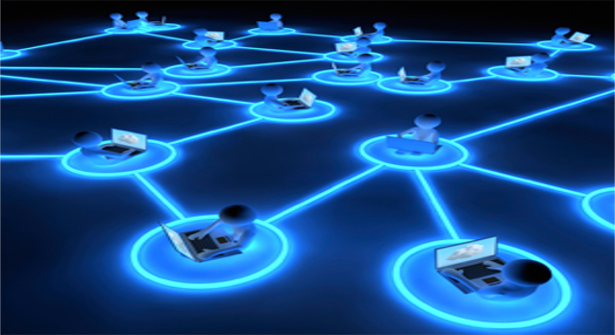
Distributed Applications
Most modern applications are distributed
Several components interact with each other
Distributed application models
"Client-Server" model – persistent socket / WebSocket connection
"Distributed Objects" model – client and server objects
DCOM, CORBA, Java RMI, .NET Remoting, …
Outdated, not used in modern apps
"Web Services" / "RESTful Web Services" model
RESTful (HTTP, REST, JSON) and heavy services (SOAP, WSDL, XML)

Slide 6

Services: Real World and SW
In the real world a "service" is:
A piece of work performed by a service provider
Takes some input and produces some desired results
E.g. a supermarket: pay some money and get some food
Has quality characteristics (price, execution time, constraints, etc.)
In the software world a "service"
Takes some input, performs some work, produces some output
Request-response model:
client requests,
server responses

Slide 7
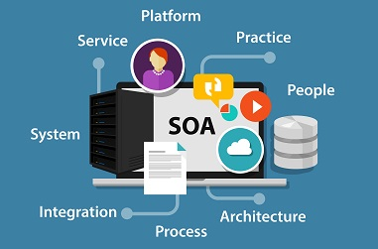
Service-Oriented Architecture (SOA)
SOA (Service-Oriented Architecture) is an architectural concept for development of software systems
Using reusable building blocks (components) called "services"
SOA == decouple the monolithic software to reusable services
Services in SOA are:
Autonomous, stateless business functions
Accept requests and return responses
Use well-defined, standard interface (standard protocols)

Slide 8
Service-Oriented Architecture (SOA)
SOA
Service
Service repository
Service bus
Contract
Implementation
Interface
Business logic
Data
Application frontend

Slide 9
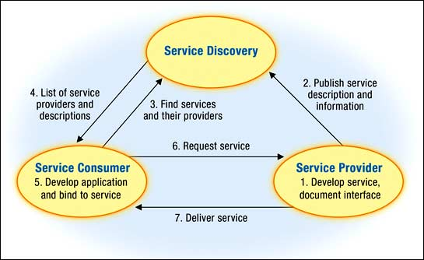
SOA conceptual model

Slide 10


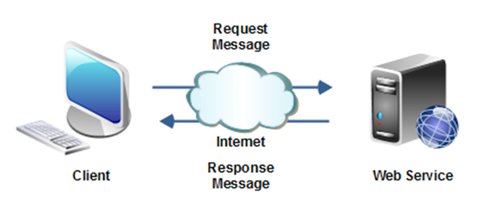
SOA Services
Autonomous
Each service operates autonomously
Without any awareness that other services exist
Stateless
Do not remember a durable state between requests
Can store state in a database and reference it by ID
Easy to scale → just add more nodes
Request-response model
Client asks, server returns an answer
Server never sends requests to the client

Slide 11
Web Services
Contract-based
Loose coupling
Abstraction Reusability
AUTONOMY
Discoverability
STATELESSNESS
Definitions, technologies and workflow

Slide 12

Web Services Definition
"A service is a discoverable resource that executes a repeatable task, and is described by an externalized service specification."
“A Web Service is a URL-addressable software resource that performs functions.”
© IBM SOA foundation

Slide 13
Web Services Definition
"A Web Service is a software application (1) identified by a URI, (2) whose interfaces and binding are capable of being defined, described and discovered by XML artifacts and (3) supports direct interactions with other software applications using XML based messages (4) via internet-based protocols“
© Sun Microsystems

Slide 14
Web Services Definition
"Web services are a new breed of Web application. They are self-contained, self-describing, modular applications that can be published, located, and invoked across the Web. Web services perform functions, which can be anything from simple requests to complicated business processes. … Once a Web service is deployed, other applications (and other Web services) can discover and invoke the deployed service.”
© IBM web service tutorial

Slide 15
Web Services and Clients
A "web service" is:
Software service that communicates over standard Web protocols
Platform independent
Independent of OS, platforms, languages, frameworks, …
Discoverable
Service registries and brokers
A "client" (consumer) uses the services
Requests something to be performed
Gets the desired result or gets an error
do NOT need to know how it is implemented

Slide 16
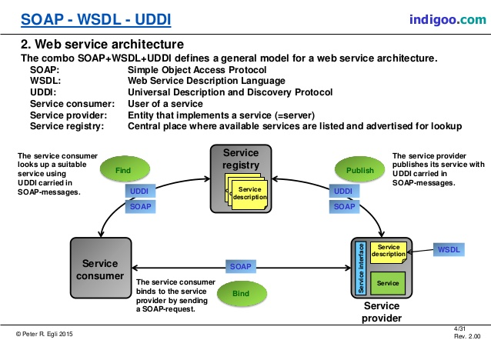
Basic WS Technologies
WSDL
Web Service Description Language
Universal Description, Discovery & Integration
Simple Object Access Protocol
UDDI
SOAP

Slide 17
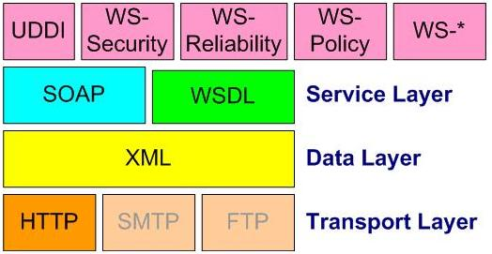
Web Services Protocols
Communication through standard protocols
HTTP, FTP, SMTP, RPC, MSMQ, ...
JSON, XML, SOAP, RSS, WS-*, ...
Classical (heavyweight) services use SOAP, WSDL, XML, WS-*
Lightweight (RESTful) services use HTTP, REST and JSON
Can be composed into complex workflows (WS-BPEL, BPMN, etc.)

Slide 18
Web Services Implementation
Web Service Provider
(endpoint)
Requestor
(SOAP client)
HTTP
server
SOAP
server
application
server
SOAP
messages
(http transport)
Application Server (web service-enabled)
provides implementation of services and exposes it through WSDL/SOAP
implementation in Java, as EJB, as .NET (C#) etc.
SOAP server
implements the SOAP protocol
HTTP server
standard Web server
SOAP client
implements the SOAP protocol on the client site

Slide 19
Web Services workflow
Find Web Service
UDDI Registry
CLIENT
List of Web Services
Get Web Service Info
Registered
Services
WSDL URL
Get Service Description
WSDL Contract
Web Service
SOAP Message
SOAP Response

Slide 20
Web Services
Contract-based
Loose coupling
Abstraction Reusability
AUTONOMY
Discoverability
STATELESSNESS
Web Services Description:
WSDL

Slide 21
WSDL Service Description
WSDL (Web Services Description Language)
Describes what a Web service can do
Names of the available methods (messages)
Input and output parameters, returned value
Data types used for parameters or result
Endpoints: ports and bindings
WSDL is an XML based, open standard from W3C

Slide 22
WSDL Specification
Define in XML Schema the message types used when invoking the service: MT1, MT2 etc.
Define (named) messages by using these types, e.g.
message m1 has type MT1
message m2 has type MT2 etc.
Define Services that consist of one or more operations; each operation is implemented by the exchange of messages
service S offers operation O1; for executing O1 first send a request message m1, then a response message m2 is returned
Define a Binding B to a specific protocol, e.g. SOAP
service S is implemented in SOAP; the SOAP messages are constructed from the abstract messages m1 and m2 by, e.g. inlining the message as body of SOAP messages
Service S is provided with binding B at the following URI's (called ports)
WSDL specification
abstract part
types
messages
operations
port types
concrete part
bindings
services and
ports

Slide 23
WSDL Example
<wsdl:definitions xmlns:apachesoap="http://xml.apache.org/xml-soap"xmlns:impl="http://localhost:8080/axis/StockQuoteService.jws" >
<wsdl:message name="getQuoteResponse">
<wsdl:part name="getQuoteReturn" type="xsd:float"/>
</wsdl:message>
<wsdl:message name="getQuoteRequest">
<wsdl:part name="symbol" type="xsd:string"/>
</wsdl:message>
<wsdl:portType name="StockQuoteService">
<wsdl:operation name="getQuote" parameterOrder="symbol">
<wsdl:input message="impl:getQuoteRequest" name="getQuoteRequest"/>
<wsdl:output message="impl:getQuoteResponse" name="getQuoteResponse"/>
</wsdl:operation>
</wsdl:portType>
<wsdl:binding name="StockQuoteServiceSoapBinding" type="impl:StockQuoteService">
<wsdlsoap:binding style="rpc" transport="http://schemas.xmlsoap.org/soap/http"/>
<wsdl:operation name="getQuote">
<wsdlsoap:operation soapAction=""/>
<wsdl:input name="getQuoteRequest">
<wsdlsoap:body encodingStyle="http://schemas.xmlsoap.org/soap/encoding/" namespace="http://DefaultNamespace"use="encoded"/>
</wsdl:input>
<wsdl:output name="getQuoteResponse">
<wsdlsoap:body encodingStyle="http://schemas.xmlsoap.org/soap/encoding/"namespace="http://localhost:8080/axis/StockQuoteService.jws" use="encoded"/>
</wsdl:output>
</wsdl:operation>
</wsdl:binding>
<wsdl:service name="StockQuoteServiceService">
<wsdl:port binding="impl:StockQuoteServiceSoapBinding" name="StockQuoteService">
<wsdlsoap:address location="http://localhost:8080/axis/StockQuoteService.jws"/>
</wsdl:port>
</wsdl:service>
</wsdl:definitions>
WSDL specification
abstract part
types
messages
operations
port types
concrete part
bindings
services and
ports

Slide 24
Web Services
Contract-based
Loose coupling
Abstraction Reusability
AUTONOMY
Discoverability
STATELESSNESS
Universal Description Discovery and Integration :
UDDI

Slide 25
UDDI
Standard for describing, publishing and finding web services
Still evolving
Use XML-based description files for services
Main components
White pages: basic contact information about an organization
Yellow pages: classification of organization based on industrial categorization
Green pages: technical description of services offered by registered organizations
Access to UDDI Registry
Standard UDDI API (accessible via SOAP)
Web browser

Slide 26
UDDI Registries
A number of companies (Microsoft, IBM, HP, etc.) run global UDDI Registries, which are a database of Web services.
A number of companies run corporate UDDI Business Registries
Supported ops:
Register a Web Service (WSDL)
Find a Web Service
These registries can be accessed using API or via a Web site interface. For example, see: http://uddi.microsoft.com/ or https://uddi.ibm.com/ubr/registry.html

